Slide 1
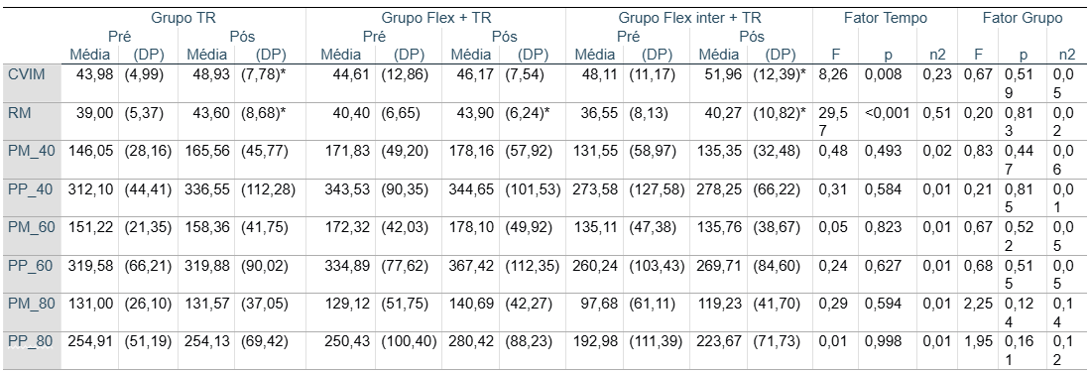
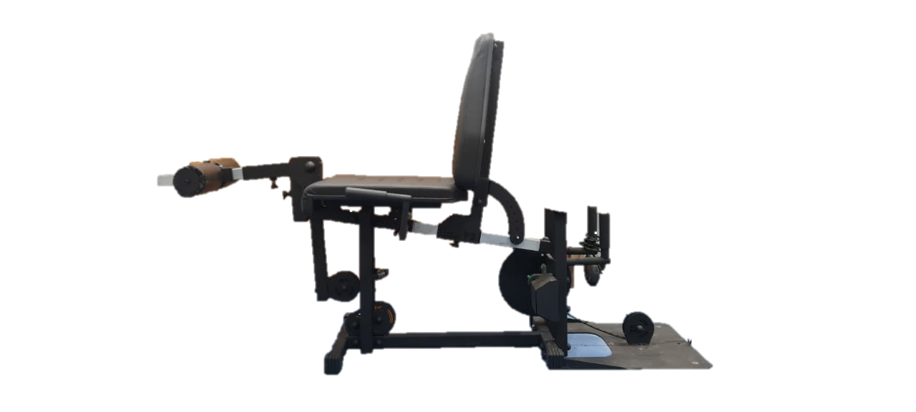
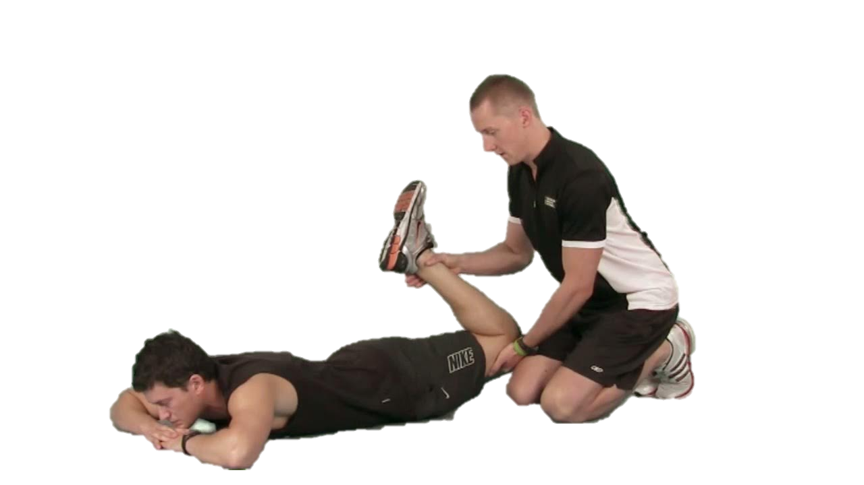
Logo da sua instituição
Logo do seu grupo/lab
EFFECTS OF A FLYWHEELS RESISTANCE TRAINING PROGRAM, WITH PRIOR STRETCHING, INTER-SET STRETCHING, OR NO STRETCHING ON FUNCTIONAL INDICATORS OF THE LOWER LIMBS
Ítalo Santiago Alves Viana*; Leonardo Silveira Goulart Silva; Maria Eduarda Araújo Lara; Izabela Mendes Alves; Maria Luiza da Cruz Santos; Cláudia Eliza Patrocínio de Oliveira; Osvaldo Costa Moreira.
*italo.viana@ufv.br
INTRODUCTION
RESULTS
Flywheel resistance training (FRT) is characterized by eccentric overload following maximal concentric actions, occurring when the eccentric-to-concentric ratio exceeds 1, increasing mechanical output in the eccentric phase.
The main results showed a significant intragroup improvement in MVIC (F = 8.26; p = 0.008; η² = 0.23) and 1RM (F = 29.57; p < 0.001; η² = 0.51) for all three groups. However, no differences were found between groups. Muscle power showed no significant changes either within or between groups.
OBJECTIVE
This study aims to analyze the effects of an FRT program with prior stretching (PS), inter-set stretching (IS), or no stretching on functional indicators of the quadriceps femoris muscle.
METHODS
30 untrained men (18-25years)
FRT
FRT
FRT
(N=10)
(N=10)
(N=10)
+
+
PS
ISS
20 sessions (4×8-12reps) with a 0.055 kg·m²;
120s recovery, group 2 (4x30s+30s), group 3 (4x30s+90s rest)
Maximum Isometric Strength (MVIC), One Repetition Max. (1RM), and peak and mean power (40%,60%,80% of 1RM);
CONCLUSION
Then, it is concluded that in the present study, FRT promoted gains in isometric and dynamic muscle strength of the quadriceps, regardless of the addition of prior or inter-set passive stretching.
A two-way ANOVA was applied for intra and inter-group analysis (p<0.05).
Logo da instituição que financiou seu estudo
Logo da instituição que financiou seu estudo
Logo da instituição que financiou seu estudo
Acknowledgment:

